Slide 1
British Airways
Customer Booking Analysis

Slide 2
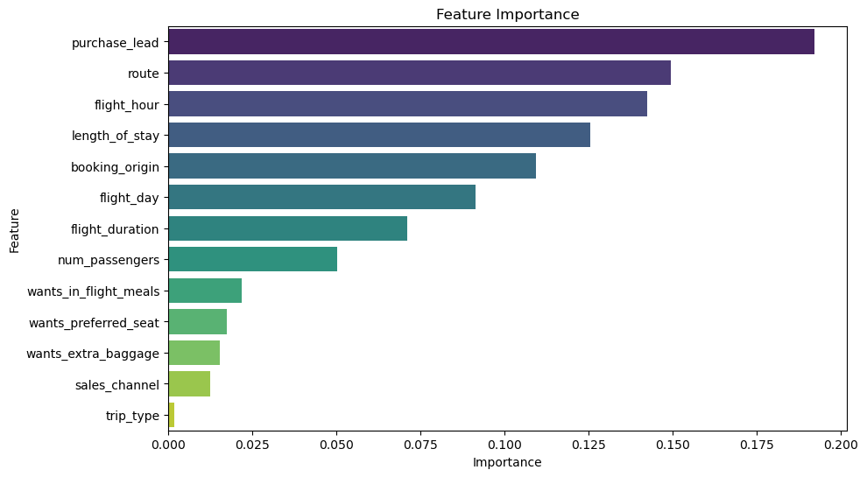
Insights drawn after making the ML Model …
Purchase_Lead which is the number of days between travel date and booking date, has the most influence on the target variable, that is whether a customer will make a booking or not.
Accuracy of the model is 85.62%, indicating that the model performs well in terms of overall correctness.
Recall score of the model is 0.1128, this suggests that the model may struggle to identify instances of the positive class, potentially leading to a higher number of false negatives. Hence, more features are required to come to a better conclusion about the prediction.

